Slide 1



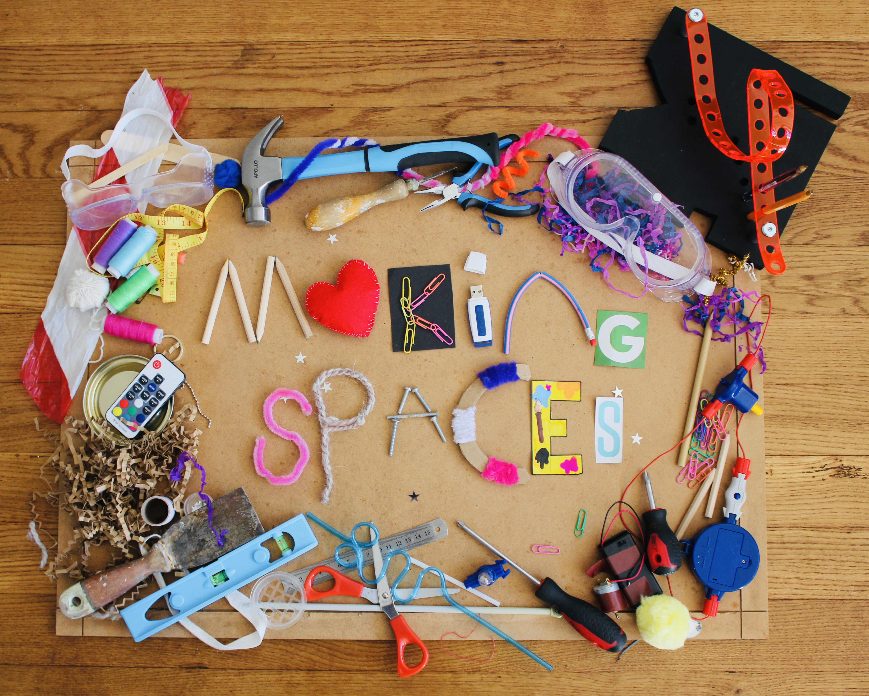
Making science “for me”: Supporting equitable engagement with science in primary and secondary classrooms
Professor Louise Archer
Karl Mannheim Professor of Sociology of Education, UCL IOE, UK

Slide 2

Background
Participation in post-compulsory science is uneven and inequitable – especially in the physical sciences – and exacerbates at each educational and professional stage
These patterns are persistent and remain despite decades of initiatives and efforts aimed at increasing and widening participation
Many interventions focus on trying to increase interest in science
But our 13 year ASPIRES research study, tracking a cohort of young people from age 10-23 (surveys with 48,000+ young people, 800+ interviews with children and parents) shows that lack of interest in science is not the main problem …

Slide 3
Many children like science but do not want to be a scientist
* Only asked of Y13 students studying at least one science A level
** Y13 data is weighted to national A level science entries

Slide 4
What factors shape these patterns?
Research by the ASPIRES project* shows that there are many interconnecting factors that shape the perception that science is ‘not for me’
Social injustices, school science practices and popular representations of science play an important role
The research also highlighted the role of ‘science capital’
*ASPIRES (2019) report: https://discovery.ucl.ac.uk/id/eprint/10092041/15/Moote_9538%20UCL%20Aspires%202%20report%20full%20online%20version.pdf

Slide 5
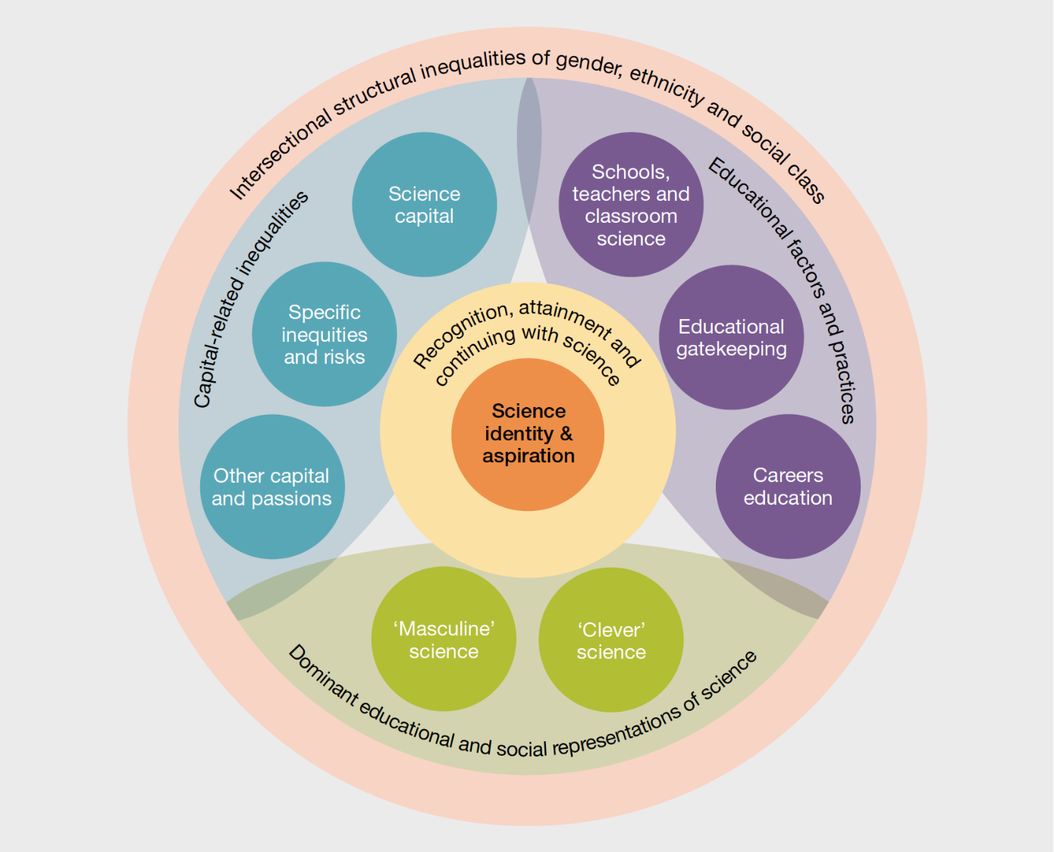
Key factors shaping science participation, age 10-19
*ASPIRES (2019) report: https://discovery.ucl.ac.uk/id/eprint/10092041/15/Moote_9538%20UCL%20Aspires%202%20report%20full%20online%20version.pdf

Slide 6
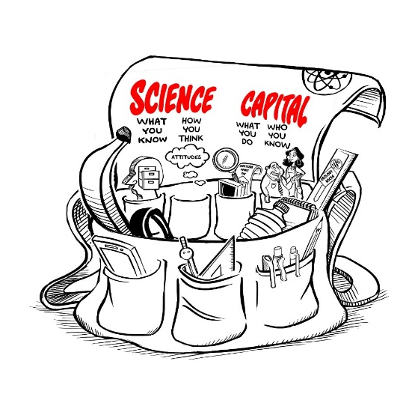
Science Capital
Developed in ASPIRES project and since extended
‘Science capital’ is a ‘conceptual holdall’, combining socialised dispositions and science-related cultural and social capital
Students whose science capital is valued, supported and recognised are significantly more likely to aspire to and participate in post-16 science and have a ‘science identity’

Slide 7
Main areas of science capital
Science literacy (“what you know”)
Science-related attitudes and values (“how you think”)
Out of school science behaviours (“What you do”)
Science at home (“who you know”)

Slide 8
Science capital and families
Produces sense of whether science is for ‘people like me’, or not:
“The other day in the car we were laughing about chemical symbols and things, so I guess it does come into the discussion quite subliminally really” (Mother).
“Science is just where it’s at in my family” (Davina, student)
“I suppose in everyday life you don’t get that much to do with it [science]” (Mother)
“They never talk about science” (Jack, student)

Slide 9
Science capital and school
Schools and teachers make a big difference to the extent that young people’s science capital (identity, interests, experiences) are recognised, valued and realised, or not, in the classroom
Evidence suggests that even when some children have extensive science capital from home, this can be mitigated and negated by school science – even highly interested and competent young people (but especially girls and those from minoritised communities) can come to see science as ‘not for me’.

Slide 10
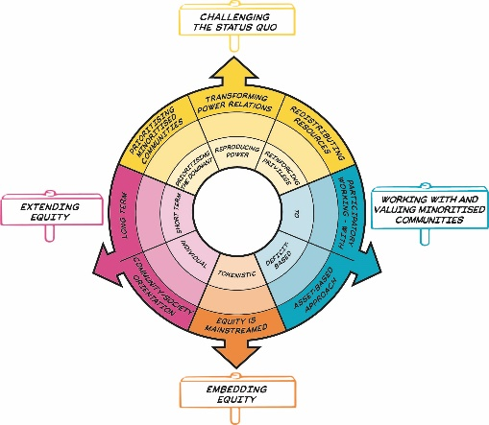
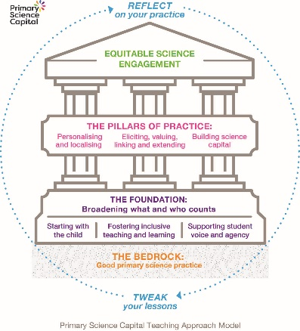
What can schools do?
Its not (just) what you do - but the way that you do it!
Underpinning values and mind set will determine the equitable potential of your practice and use of the SCTA
Two elements: the Equity Compass and the Science Capital Teaching Approach

Slide 11


Science Capital Teaching Approach
(P)SCTA is based on the idea that making changes to everyday teaching practice – not trying the change the child – can be an effective and sustainable way to help make a difference
Based on ideas of equity and social justice: adapting practice differentially according to need and trying to challenge and change the practices that reproduce injustices
@_ScienceCapital @PrimarySciCap

Slide 12
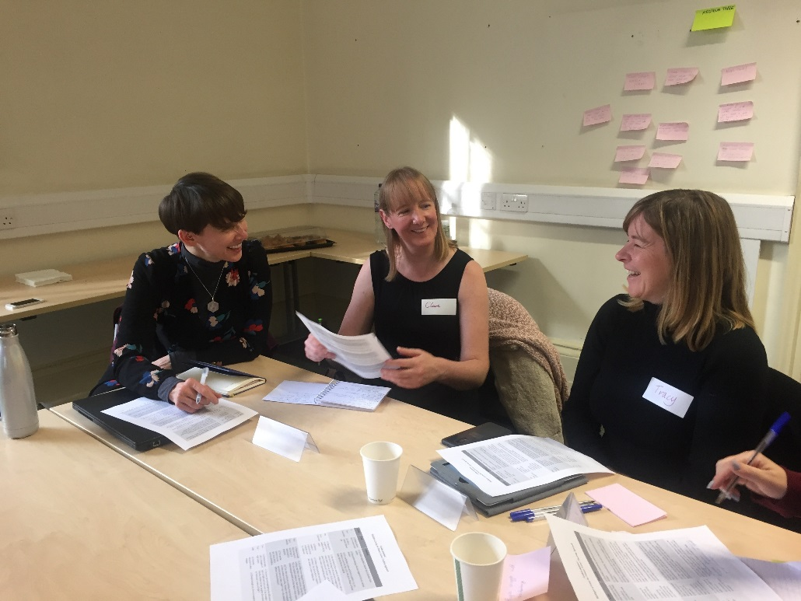
Background to the approach
Builds on and extends previous worked conducted with secondary schools (over 4 years with 40+ teachers from schools in London, Newcastle, York and Leeds)
New primary model and handbook has been co-developed with 20 partner teachers over 2 years, funded by PSTT and The Ogden Trust
@_ScienceCapital @PrimarySciCap

Slide 13
The Primary Science Capital Teaching Approach
Builds on existing good teaching practice
Reflect and tweak existing lessons
Can be used with any curriculum
Supports whole-school implementation
@_ScienceCapital @PrimarySciCap

Slide 14
Bedrock of good science teaching practice
The approach builds on the existing research on good primary science teaching practices.
@_ScienceCapital @PrimarySciCap

Slide 15
Foundation: Broadening what and who counts
Students do not just find science concepts difficult – some struggle to identify and engage with science, it feels alien to them
Challenge stereotypes and dominant ideas and representations of science, such as ‘who does science’, what constitutes ‘doing’ science and idea that science is only for ‘clever’ students.
Teachers reflect on who and what sorts of behaviours get valued as indicating a ‘good science student’/‘being good at science’ in my lessons?
@_ScienceCapital @PrimarySciCap

Slide 16
Foundation: Broadening what and who counts
Broaden what counts using these techniques
Start with the child: Instead of focusing on the learning objective, try and focus on what the child ‘knows’ and brings with them in relation to the science topics
Fostering inclusive teaching and learning: Create a classroom where children who do not have certain resources are not unnecessarily disadvantaged. Make an effort to value wider ways of ’doing science’
Supporting voice and agency of the child: Create a classroom where children’s voices are heard and validated. Use the child’s voice to direct the lessons so that children develop a sense of ownership/agency towards the science topics
@_ScienceCapital @PrimarySciCap

Slide 17
Pillar: Personalise and Localise
Go beyond contextualising science - personalise and localise it to make relevant to your particular students’ everyday lives
Approach looks different in every classroom – because students are different
“If kids can talk about their experience, express themselves or their ideas – I find they’re far more engaged and they value it a lot more.[…] When they’re talking about something that they personally know or care about, you can see they’re happy, they’re excited” (Secondary science teacher, 2016-2017)
@_ScienceCapital @PrimarySciCap

Slide 18
Pillar: Meaningfully Elicit, Value, Link & Extend
Way to support students to feel valued and connected to science
Teachers elicit students’ experiences, skills and home knowledge (what students ‘bring with them’) in relation to a topic, value (and legitimate) these, and link them to science connections
@_ScienceCapital @PrimarySciCap

Slide 19
Pillar: Building science capital
Actively cultivate, develop and build science capital dimensions, e.g.
Knowledge about the transferability of science
Science media consumption
Talking about science in everyday life
@_ScienceCapital @PrimarySciCap

Slide 20
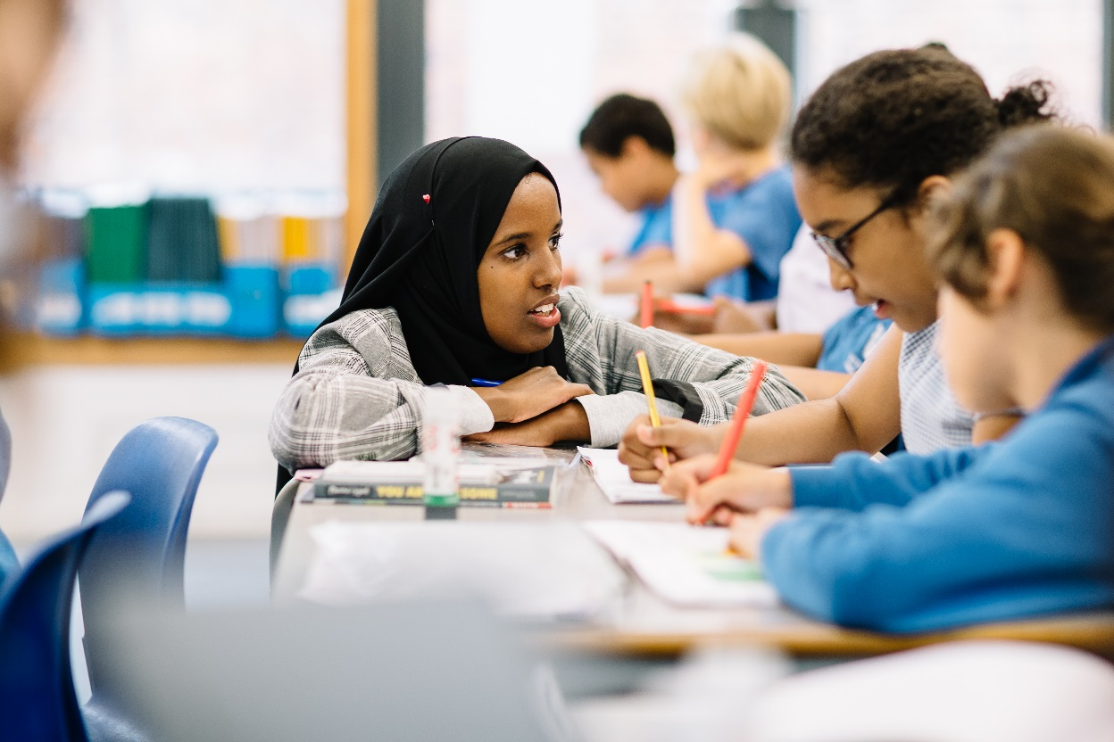
Impact of the Approach
@_ScienceCapital @PrimarySciCap

Slide 21
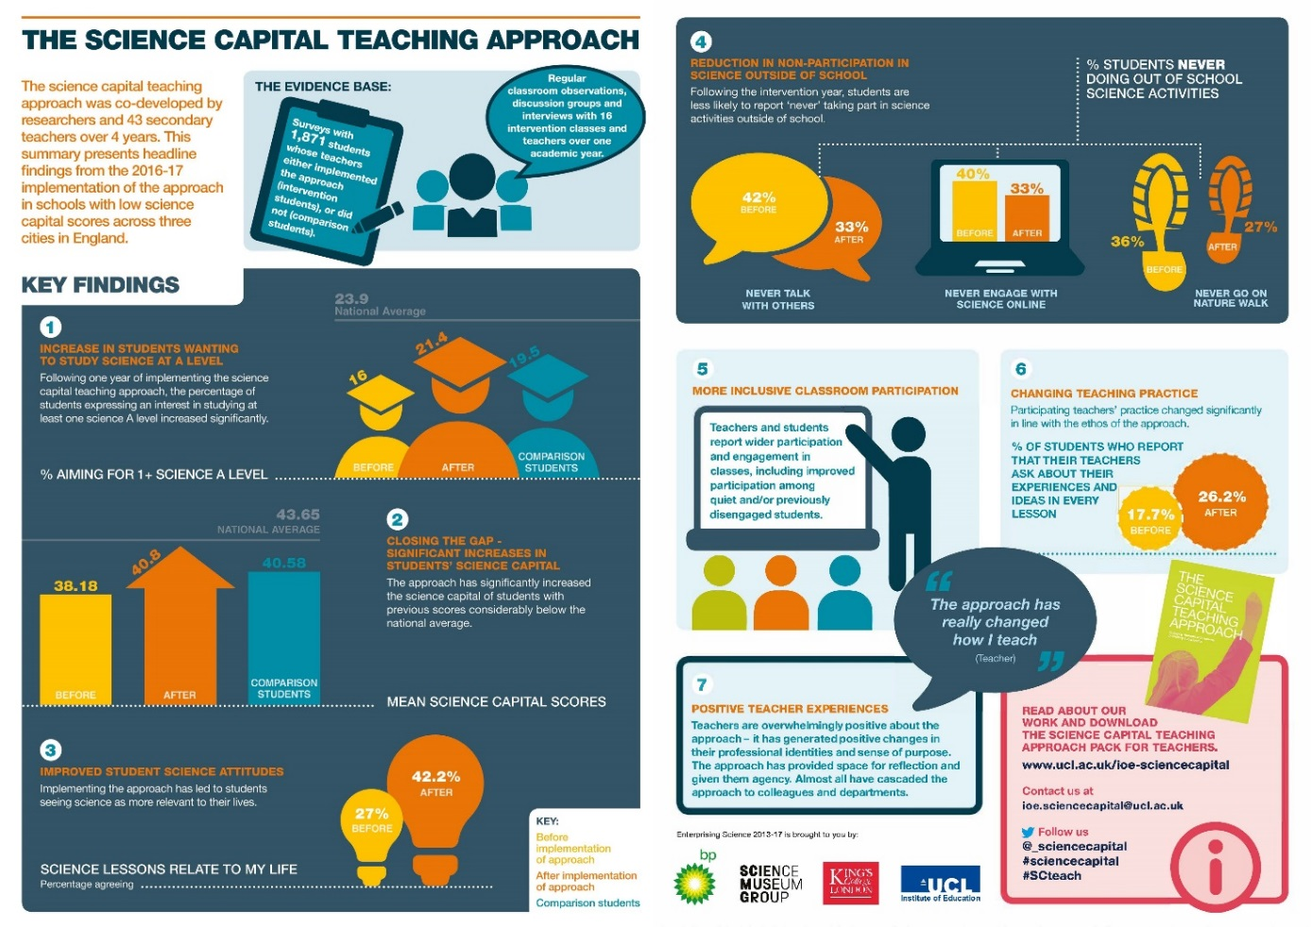
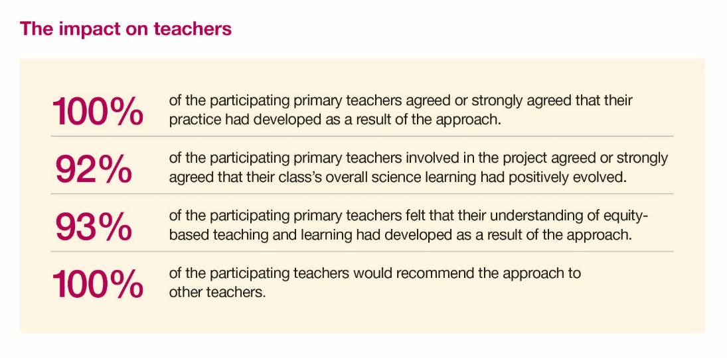
Secondary
Primary

Slide 22
What our teachers say
I was quite sceptical to start with, but I saw it made such a huge difference! The approach totally changed the classroom experience … I saw the children sit up in their chairs, look straight at me, and I could see them thinking, ‘Yes, I am part of this – I have something important to say’. Being able to share their own life experiences and knowledge with the other children gave them a huge sense of achievement.
(Year 4 teacher, Midlands)
@_ScienceCapital @PrimarySciCap

Slide 23
What our teachers say
“It’s been the best professional development I’ve done. In ten years of teaching, I think it’s the only thing that has really, really made me evaluate my practice.” (Year 6 teacher, South Coast)
@_ScienceCapital @PrimarySciCap

Slide 24
Concluding points
Importance of intentionally foregrounding equity – not doing so is not ‘neutral’
It’s not what you do but HOW and WHY that you do it – values and mind set are key
The Equity Compass and (P)SCTA is for everyone: The focus on critical reflection about power and injustice can be applied to any curriculum.
The approach focuses on changing practice, not children – valuing the identities, experiences, histories and ideas of all children in the class and changing how science is represented, taught and experienced
Small changes can make a difference, but they need to be incorporated as standard practice (not ‘one-offs’)
The Equity Compass and PSCTA approach supports teachers to use science as a vehicle for supporting children’s voice, agency and active citizenship, rather than seeing the value of learning science as being only in the supply of future scientists.
Using the compass and (P)SCTA supports young people’ critical STEM agency – taking action on issues that matter to them and their communities

Slide 25

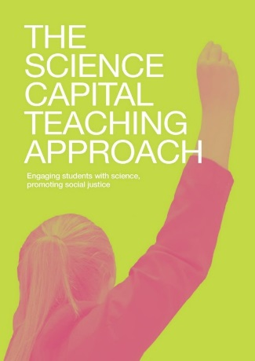
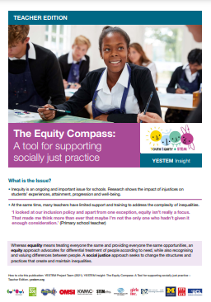
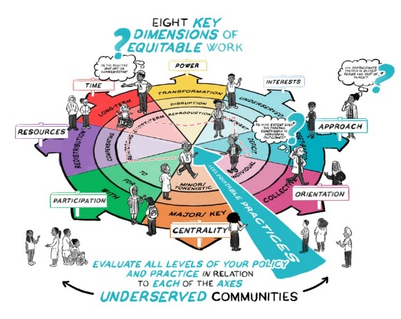
Contact details and resources
Science Capital Teaching Approach
To order your own hard copy of The Primary Science Capital Teaching Approach: Teacher handbook – please sign up using this link:
https://forms.gle/7tm9LK61hwwAXnCS6
Secondary Science Capital Teaching Approach Handbook and resources:
https://discovery.ucl.ac.uk/id/eprint/10080166/1/the-science-capital-teaching-approach-pack-for-teachers.pdf
Equity Compass
To download the Equity Compass for teachers: http://yestem.org/wp-content/uploads/2021/09/Equity-Compass-Teacher-Edition.pdf
2 minute animation explaining the Equity Compass: https://www.youtube.com/watch?v=WE4ksRCEoyA

Slide 26


Contact our projects | Twitter | Website
ASPIRES | @ASPIRESscience | https://www.ucl.ac.uk/ioe/departments-and-centres/departments/education-practice-and-society/aspires-research
YESTEM | @yestem_UK | www.ucl.ac.uk/ioe-yestem
Making Spaces | @M4kingSpaces | m4kingspaces.org
Primary Science Capital | @PrimarySciCap | https://www.ucl.ac.uk/ioe/departments-and-centres/departments/education-practice-and-society/science-capital-research/primary-science-capital-project

